Slide 1

Movie Recommendation System
Aniket Gholve
Ritik Raj
Om Sharma
Raja Kumar

Slide 2
Content
Introduction
Problem Statement
Data Base
Proposed Solution
Experiment Results
Conclusion

Slide 3
Introduction
People seek information via words, recommendation letters, news reports etc.
Recommendation systems imitate this social process to enable quick filtering of the information on the web
Lots of companies try to offer services that involve recommendations to address the right user groups.

Slide 4
Problem Statement
Providing related content out of relevant and irrelevant collection of items to users of online service providers
Movie Recommendation System aims to recommend movies to users based on user-movie choosen.
Given a set of users with their previous ratings for a set of movies, can we predict the rating they will assign to a movie they have not previously rated?
Ex. “Which movie will you like” given that you have seen X-Men, and users who saw these movies also liked “X-Men Origins : Wolverine, X-Men II, X-Men : The Last Stand ”?

Slide 5
Dataset Used
The main Movies Metadata file. Contains information on 5,000+ movies featured in the Kaggle Movie dataset.
It contain name of directors , Actors and what type of movie is it.
The dataset consists of movies released on or before July 2017.

Slide 6
Proposed Solution
The similarity between item vectors can be computed by three methods:
1. Cosine similarity
2. Euclidian distance
3. Pearson’s correlation
We have used Cosine Similarity to solve this problem:
Cosine Similarity
Cosine similarity among two objects measures the angle of cosine between the two objects. It compares two documents on a normalized scale. It can be done by finding the dot product between the two identities.

Slide 7
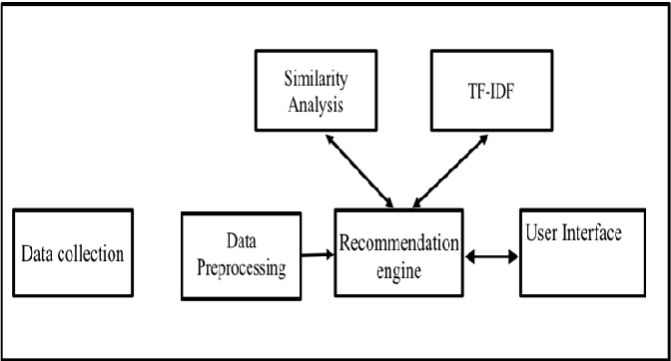
Algorithm Used

Slide 8
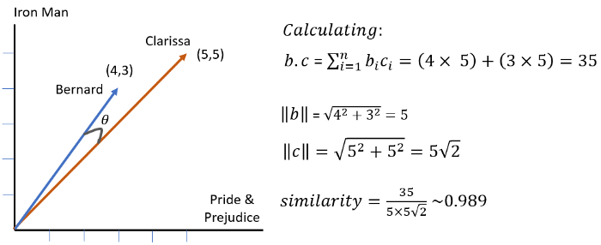
Experiment Results

Slide 9
Experiment Results
Current Netflix system had RMSE 0.95 before they conducted a challenge to improve this RMSE.
Winner of the challenge had RMSE 0.85, which is 10% improvement.
We reached RMSE of 1.24 which is still high considering 0.85, because they used hybrid of different Collaborative Filtering techniques.

Slide 10
Conclusion
Recommendation systems provide content for us by taking what other people recommend as well as our selections into account
Content Filtering is a widely used solution for this problem which we make use of in our project

Slide 11
Manual testing and Automation testing
Group no 37
Submitted By
Aniket Gholve 405B027
Ritik Raj 405B064
Om Sharma 405B073
Raja Kumar 405A069

Slide 12
Defination
Manual testing is the process of manually testing software for defects.
It requires a tester to play the role of an end user whereby they use most of the application's features to ensure correct behavior.
To guarantee completeness of testing, the tester often follows a written test plan that leads them through a set of important test cases.
Automation Testing is a software testing technique that performs using special automated testing software tools to execute a test case suite.
The automation testing software can also enter test data into the System Under Test, compare expected and actual results and generate detailed test reports.
Software Test Automation demands considerable investments of money and resources.

Slide 13
Testing Process
Understand The Requirements
Write Test Cases
Conduct The Tests
Further Investigation
Log Bug Reports
Report On The Test Results
Test Tool Selection
Define scope of Automation
Planning, Design and Development
Test Execution
Maintenance

Slide 14
Testing Types
Black Box Testing:Black box testing is one type of manual testing that examines the software’s functionality without peering into its internal structure and coding.
White Box Testing:Another manual testing type is white box testing which is also known for glass box testing. It is used to test the internal coding and infrastructure of the software.
Unit Testing:In this manual testing type, the components of the software are tested. The main goal of this testing is to determine whether each component of the software is working properly or not.
Smoke Tests:Smoke tests are a type of Functional test that only covers the most crucial features of a software solution to ensure that it could be further tested without “catching fire,” hence the name Smoke Tests.
Security Tests:Security tests cover Functional and Non-functional tests that screen the software for any vulnerabilities. They reveal weaknesses and any potential exploit in a system.
Performance Tests:Performance tests are often Non-functional tests that help testers evaluate criteria like responsiveness and stability as the software handles load and stress.

Slide 15
Advantages
No Environment Limitations
Programming Knowledge is not required.
Recommendable for Dynamically changing GUI designs.
Recommendable for Usability Testing.
Manual testing allows for human observation, which may be more useful to find potential defects.
Automated testing improves the coverage of testing as automated execution of test cases is faster than manual execution.
Automated testing reduces the dependability of testing on the availability of the test engineers.
Automated testing provides round the clock coverage as automated tests can be run all time in 24*7 environment.
Automated testing takes far less resources in execution as compared to manual testing.

Slide 16
Disadvantages
Manual Testing requires more time or more resources, sometimes both Time and Resources.
Less Accuracy.
Performance testing is impractical in Manual testing.
Comparing a large amount of data is impractical.
Processing change requests during software maintenance takes more time.
Automated testing is very much expensive than the manual testing.
It also becomes inconvenient and burdensome as to decide who would automate and who would train.
It has limited to some organisations as many organisations not prefer test automation.
Automated testing would also require additionally trained and skilled people.

Slide 17
References
Xiaoyuan Su and Taghi M. Khoshgoftaar, “A Survey of Collaborative Filtering Techniques,” Advances in Artificial Intelligence, vol. 2009, Article ID 421425, 19 pages, 2009
R. M. Bell, Y. Koren and C. Volinsky, "The BellKor solution to the Netflix grand prize," March 2012. [Online]. Available at:
http://www2.research.att.com/~volinsky/netflix/Progress Prize2007BellKorSolution.pdf
A Nearest Neighbor Approach using Clustering on the Netflix Prize Data

Slide 18
Thank You

